Slide 1
Week 8:
Inheritance
Overriding
Visibility modifiers
Inheritance Chains
toString
Abstract Classes/methods
Interfaces

Slide 2
Why can’t our robot turn right????
robot:Hmmmm:PartA

Slide 3
Inheritance –Money for nothing and code for free!
inheritance:Start -PartA

Slide 4
Inheritance
One of the four pillars of OOP!

Slide 5
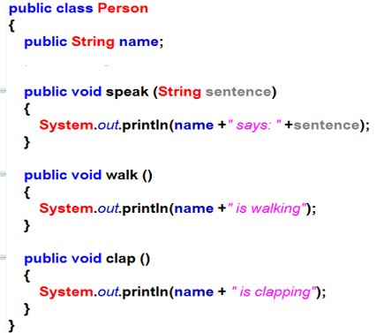
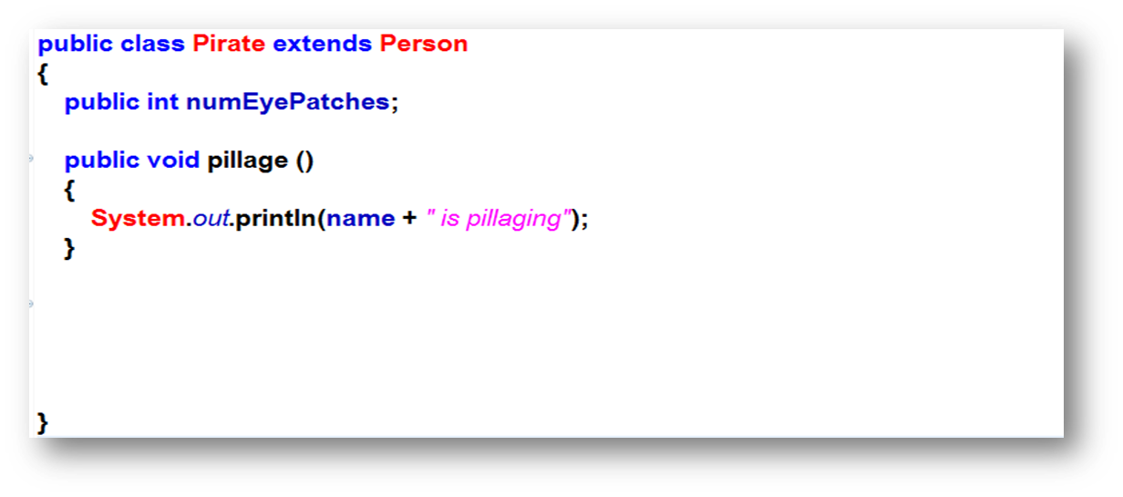
Get code for free and add to it!
Base class or Parent class
or Super class
Inheritance
Child class or sub class or derived class
Free Code!
We can then add our own functionality on top of the code we inherited!

Slide 6
So, how cool is inheritance!
Code for free!
Never have to re-invent the wheel!
Can build on what others have written!
We can get paid more and work less!
However, with great power comes great responsibility
There are some rules we should follow.

Slide 7
Rule #1
We should only use inheritance when the child class is a more specific version of the parent class.
For example:
a Student is a more specific version of a Person (we can inherit!)
But a Truck isn’t a more specific version of a Person (we shouldn’t inherit!)

Slide 8
Yourturn1 – Part A

Slide 9
Hmmm…Pirates don’t talk like that!
inheritance:Start-PartB

Slide 10
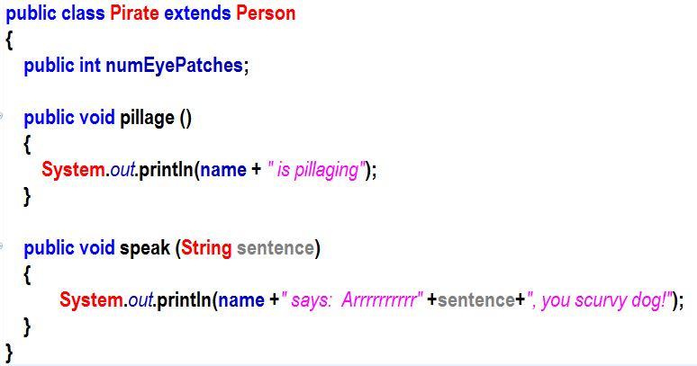
Overriding
Base class or Parent class
or Super class
Inheritance
Child class or sub class or derived class
Free Code!
Overridden

Slide 11
Overriding vs Overloading
Overloading involves writing a method more than once but with different method signatures.
Overriding means writing a method with the exact same method signature in a child class.
Use @Override to prevent mistakes!

Slide 12
Annotations! @Very meta!
Java has a number of annotations that are not actually code but contain information about the code.
For example, @Override tells the compiler that the method you are about to write will override a method in the parent class.
The compiler will now give an error if the method you write doesn’t match the method in the parent class.
This is a clever thing for a programmer to do as a double check that there hasn’t been a spelling mistake or a method signature mistake!
Trust me…thinking that you’ve overridden a method when you haven’t is painful to find!

Slide 13
Annotations! @Very meta!
Turns out there are three kinds of annotations:
Compiler directives - things like @Override or directives to suppress warnings, etc.
Compile-time and processing – Many frameworks use custom annotations to allow your code to hook into the framework. You will use a lot of these when you learn Spring Boot.
Runtime processing — Some annotations can actually be used at runtime but we won’t be discussing them in this course.

Slide 14
Yourturn1 – Part B

Slide 15
Let’s fix our instance variable because we know better than to make it public
inheritance:Start –PartC & D

Slide 16
hmm…private problems?
We know public and private…
Introducing package private and protected.

Slide 17
Visibility modifiers
We know a class can be public
We know that a class member (instance variable or method) can be public or private.
Turns out that they can also be somewhere between public and private

Slide 18
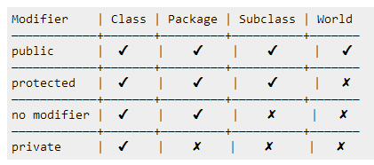
Member Modifiers (Instance Variables and Methods)
in the same package or a child (sub)class in a different package
any class, anywhere
only within the same class
in the same package
default/(leave blank)
‘package private’
public
private
protected
package private
Note that we still need to import classes if they are in different packages

Slide 19
Class Modifiers
can only be seen by classes that are in the same package
There is also something known as inner classes which can be private but that’s a topic for a different course…
can be seen by any class but must be imported if it’s in a different package
default/
‘package private’
public
You cannot make private Classes…Yet!
Technically you can make private inner-classes inside of outer-classes
http://www.tutorialspoint.com/java/java_access_modifiers.htm

Slide 20
Yourturn1 – Part C

Slide 21
Let’s add a constructor to Person
inheritance:Start – PartE

Slide 22
Inheritance and constructors
Things we know:
A constructor runs as soon as the object has been instantiated.
If we don’t explicitly write a constructor, the compiler will automatically write a default, empty constructor.
Every time we use new, a constructor runs (even if it is an empty, default constructor)
Things we need to know
Constructors aren’t inherited.
At least one constructor in the parent class must run!
This can be the default constructor or a different constructor
We can run a constructor in the parent class with the keyword super
The super keyword must be the first line in the child constructor.
If we don’t call the parent constructor, the jvm will try to call the default (empty) constructor in the parent.

Slide 23
Yourturn1 – Part D

Slide 24
What do we know about super?
A parent class constructor MUST run when a child is created (it could be the empty default constructor, but it runs)
We can use super by itself to call a parent constructor.
We can use super.method() to call an individual method in the parent class

Slide 25
Inheritance chains
We can have infinite inheritance as long as each class only inherits from a single parent.

Slide 26
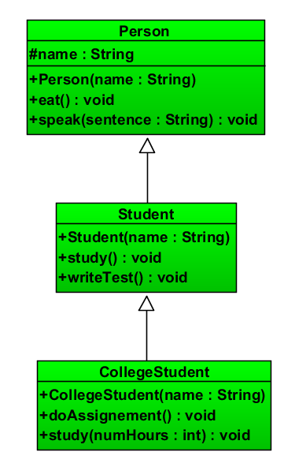
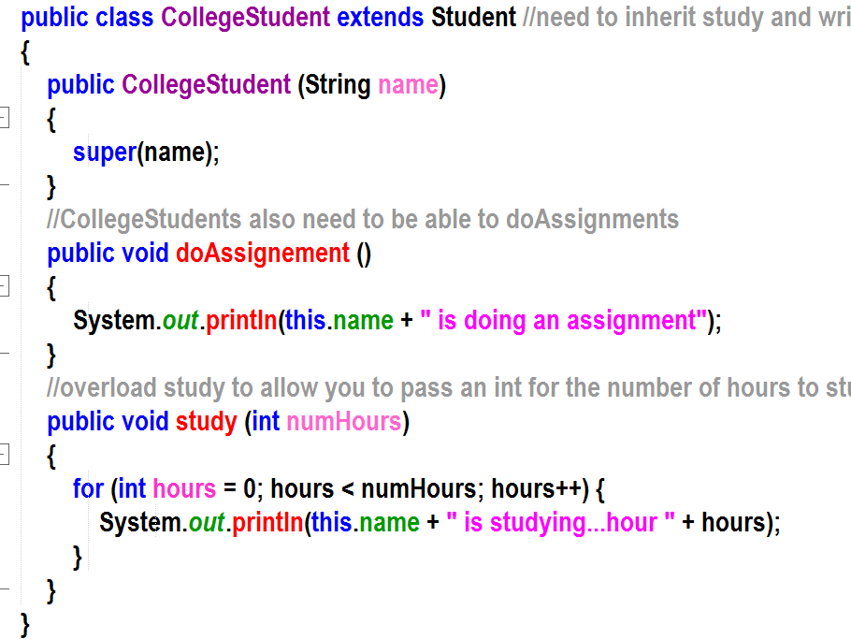
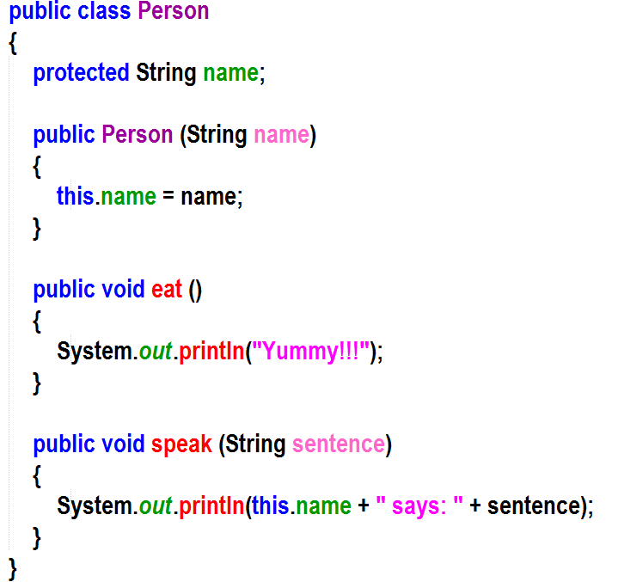
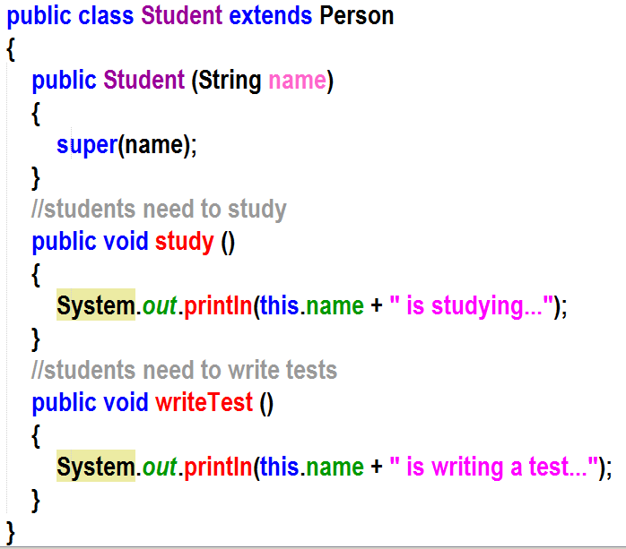
Inheritance Chain

Slide 27
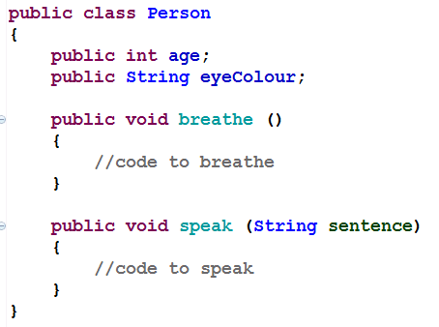
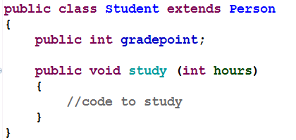
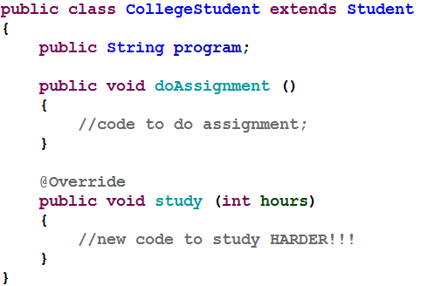
A rule of thumb…
Any child classes should pass the “is a” test.
Student is a Person
CollegeStudent is a Student
Each subclass is a more specific type of the parent class.

Slide 28
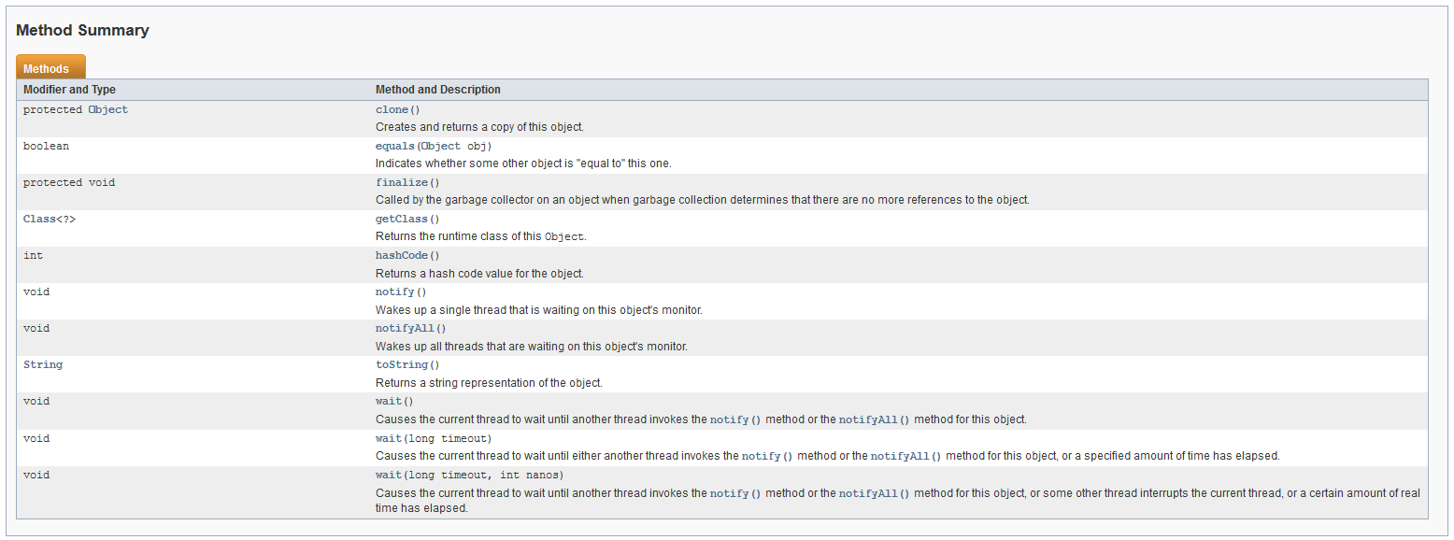
Inheritance chains
Everything is derived from the Object Class
This is why there are extra methods in your code hints!!!

Slide 29
Let’s talk about the toString method in the Object class

Slide 30
Yourturn1 – Part E

Slide 31
Overriding toString to make it more useful
tostring:Start

Slide 32
Yourturn1 – Part F

Slide 33
Why can’t our robot turn right????
Week-08:robot:Hmmmm:PartB

Slide 34
Yourturn 2

Slide 35
Yourturn 3 – Part A & B

Slide 36
Moving on to Abstract Classes…
So, all of the classes we’ve written so far are what are known as concrete classes. This means we can instantiate objects from them.
What is the biggest difference between an abstract class and a concrete class?
We can’t instantiate Abstract classes!!!
Ok, then why would we even want an abstract class?

Slide 37
Let’s build some FOOD objects
Week-08:abstractclasses1: Start

Slide 38
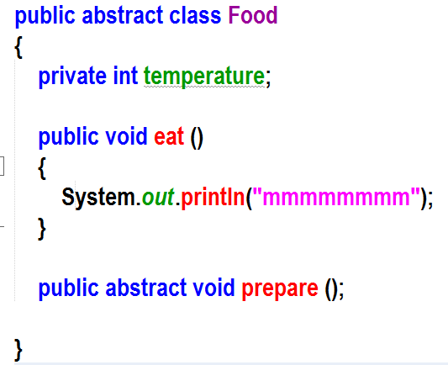
{abstract} Food
Can I order a food???
+temperature
+eat ()
+prepare () {abstract}
Ice Cream
Pancakes
Pizza
+prepare ()
+prepare ()
+prepare ()

Slide 39
{abstract} Food
X
✓
+temperature
✓
+eat ()
+prepare () {abstract}
Ice Cream
Pancakes
Pizza
+prepare ()
+prepare ()
Pizza must implement +prepare ()

Slide 40
{abstract} Food
+temperature
Pizza is abstract and can’t be instantiated, so no error!
✓
✓
✓
+eat ()
+prepare () {abstract}
Ice Cream
Pancakes
{abstract}Pizza
+prepare ()
+prepare ()
✓
X
VegePizza is concrete but doesn’t implement +prepare
HawaiianPizza
VegePizza
+prepare ()
Hawaiian is concrete but implements +prepare!

Slide 41
{abstract} Food
Food
+temperature
+temperature
✓
+eat ()
+prepare () {abstract}
+eat ()
+prepare () {abstract}
Ice Cream
Pizza
Pancakes
+prepare ()
+prepare ()
+prepare ()
✓
X
Remember our ‘is a’ test
HawaiianPizza
Olive Truck
+slicePepperoni

Slide 42
Yourturn 3 – Part C

Slide 43
yourturn4:

Slide 44
OK, I get inheritance, I understand how to override a method in the subclass that exists in the superclass, I even understand abstract classes and abstract methods but I still have some have questions…
What if I want to inherit from multiple classes?
What if I have a bunch of different kinds of classes that I want to force to implement the same method?

Slide 45
X
For instance…
ClassB
ClassA
+methodB1 ()
+methodB2 ()
+methodA1 ()
+methodA2 ()
✓
ClassC
We can only inherit from one parent class
+methodC1 ()
✓
ClassD
+methodD1 ()

Slide 46
Introducing Interfaces
An interface is a contract.
If I make my class implement an interface, I must implement all of the methods specified in the contract.
An interface is never instantiated. Sound familiar?
A Class can implement multiple interfaces!
Why is this useful?
Imagine that you have 30 programmers reporting to you and you want to divvy up the classes to them…
Actually, interfaces become very useful when we start talking about polymorphism

Slide 47
The Pirate and the Parrot
Week-08:interfaces:Start

Slide 48
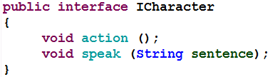
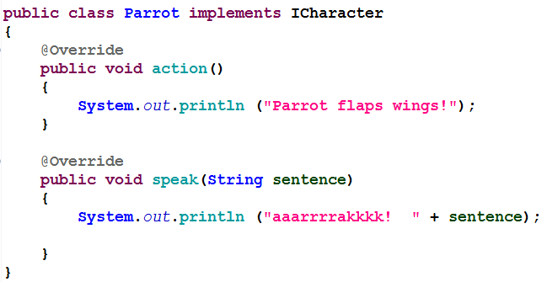
Let’s take a look…
Notice we don’t even need to
type public
Keyword interface
Notice the ;
List of abstract methods that must
be implemented
Keyword implements
Methods specified
by
Icharacter
interface

Slide 49
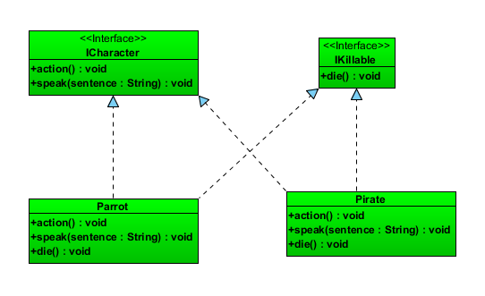

Slide 50
Interfaces
Can’t be instantiated
Are contracts for methods. Any class that implements an interface must implement all of the methods contained in the interface contract!
The interface only requires the method to be implemented with the required parameters and return value. It doesn’t specify how we implement it!
We can use an interface type as a reference variable to point to any object that implements that interface.
Interfaces can’t have instance variables…If we add an instance variable to an interface, the compiler will turn it into a static final variable…

Slide 51
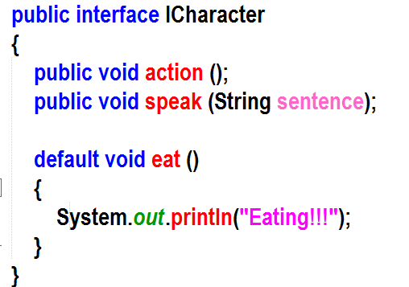
New for Java 8
Interfaces can now contain default methods
Traditional list of abstract methods in an interface
hmmm…why would we ever use abstract classes then?
Interfaces still can’t specify instance variables.
Don’t worry, this won’t be on the exam.
New, default method…much like concrete methods in abstract classes

Slide 52
So…interfaces…big deal, right?
It turns out that interfaces are a huge deal, once we add polymorphism into the mix!
For now, think about this.
Interfaces declare behavior.
Classes define behavior
The difference is subtle, but important!
Interfaces, combine with polymorphism give us useful abstraction!

Slide 53
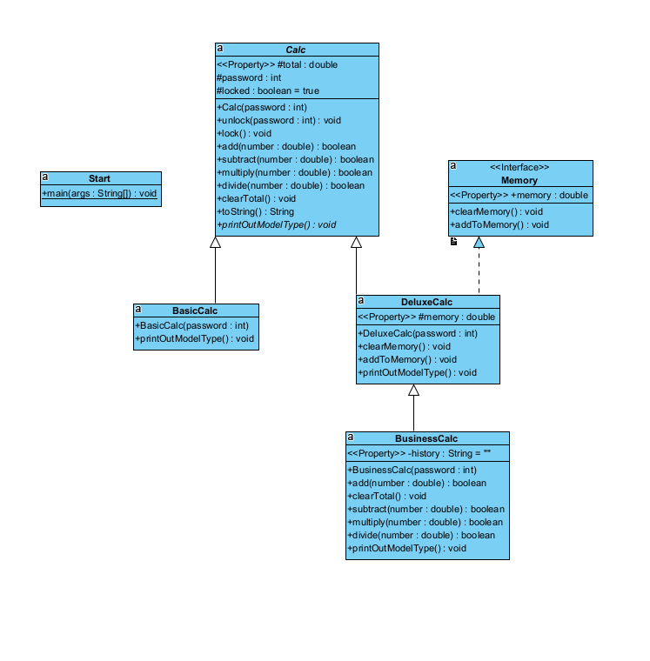
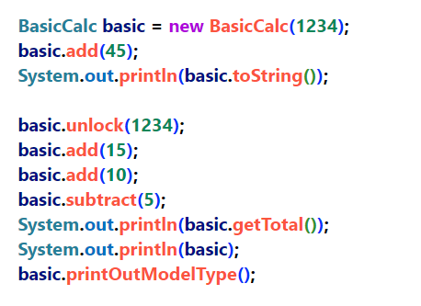
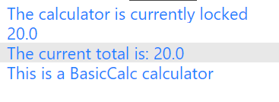
Starting yourturn5 together

Slide 54
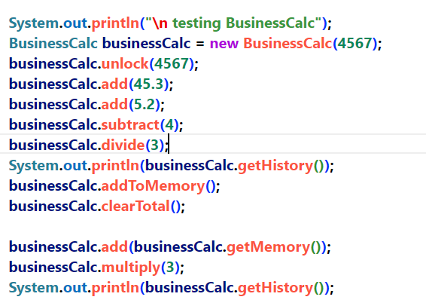
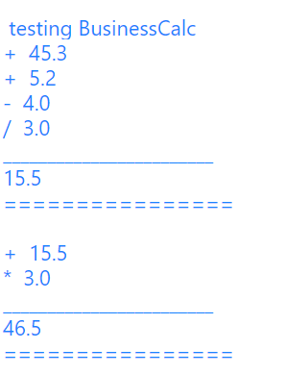
Starting yourturn5 together

Slide 55
yourturn5

Slide 56
X
ClassA
ClassB
Riddle me this...
+methodA1 ()
+methodA2 ()
+methodB1 ()
+methodB2 ()
✓
ClassC
Let’s Fix this...
+methodC1 ()
✓
ClassD
+methodD1 ()

Slide 57
ClassA
<<interface>>
Interface1
✓
+methodA1 ()
+methodA2 ()
+methodB1 ()
+methodB2 ()
✓
ClassC
+methodC1()
+methodB1 ()
+methodB2 ()
✓
ClassD
+methodD1 ()

Slide 58
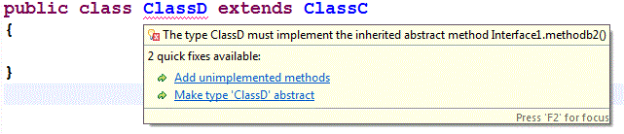
ClassA
<<interface>>
Interface1
+methodA1 ()
+methodA2 ()
✓
+methodB1 ()
+methodB2 ()
{abstract} ClassC
+methodC1()
+methodB1 ()
X
How about this???
ClassD
+methodD1 ()

Slide 59
ClassA
<<interface>>
Interface1
✓
+methodA1 ()
+methodA2 ()
+methodB1 ()
+methodB2 ()
{abstract}
ClassC
+methodC1()
+methodB1 ()
✓
ClassD
+methodD1 ()
+methodB2 ()

Slide 60
Difference between Abstract Classes and Interfaces
 | Abstract Class | Interface
Instance Variables | no restrictions | public static final only
Methods | No restrictions | public abstract (new default!)
Constructors | Can be invoked by subclass | No constructors
other | can have concrete and abstract methods mixed | abstract methods (and new default methods – but no access to instance variables!)
The most important differences:
Abstract classes can have instance variables so the concrete and abstract methods can access those instance variables (the can see the object’s state).
Interfaces can’t specify instance variables so the abstract and default methods can’t access the object’s state!

Slide 61
Who am I?
I am the OOP concept that allows ClassA to make use of instance variables and methods that were written in ClassB as if they existed the ClassA.
Inheritance!

Slide 62
Who am I
I am the keyword that allows my class to inherit methods
and instance variables from the superclass …who am i?

Slide 63
Who am I?
Any class that implements me must implement all of my methods. Who am I?
Interface
I can be inherited from but I can’t be instantiated. Who am I?
Abstract Class
I store nuts for the winter. Who am I?
A squirrel

Slide 64
Who Am I
I am either the superclass or the subclass…
Who am I?
SuperClass

Slide 65
Who am I?
<<interface>>
IEye
<<interface>>
IPrintable
+blink() : void
+wink() : void
+print () : void
Test
I am the text that belongs in here…Who am I?
+print () : void
+blink () : void
+wink () : void

Slide 66
Person
+age : int
+eyeColour : String
+breathe () : void
+speak (sentence : String)
This is an example of me.
Who am I?
Student
+gradePoint: Integer
Inheritance
+study (hours : int) : void
Inheritance chain is an even better answer
CollegeStudent
+program : String
+doAssignment () : void
+study (hours: int):void

Slide 67
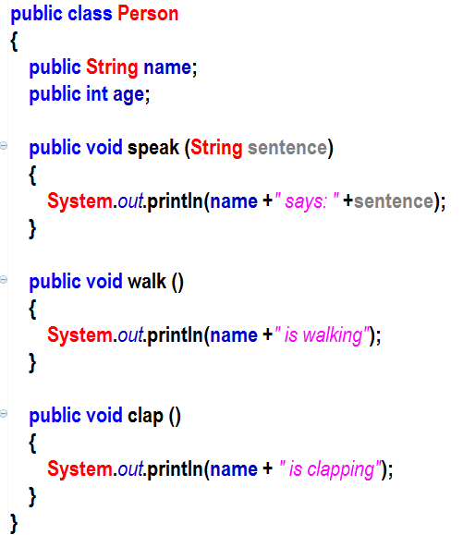
Reviewing Inheritance
Inheritance
Base class or Parent class
Child class or sub class
Free Code!
Overriding

Slide 68
More about super
We can use super to call any method in the parent class.
If we just say super, we are calling a constructor in the parent class.
If we say super.addToCart(), we are calling the addToCart method in the parent class.

